Slide 1
CZ4034
Information Retrieval Project Presentation
Poh Ying Xuan
Prem Adithya Suresh
Muhammad Al-Muhazerin
Tan Jian Wei
Kong Alson
Sam Jian Shen

Slide 2
Outline
Introduction
Crawling
Indexing and Querying
Classification

Slide 3
Introduction

Slide 4
System Introduction
Objective
Provide stock sentiments analysis to newbie investors
Notes:
The objective of our system is to provide stock sentiments analysis to newbie investors

Slide 5
Team Members
Crawling
Poh Ying Xuan, Prem Adithya Suresh, Muhammad Al-Muhazerin
Indexing and Query
Kong Alson, Tan Jian Wei, Sam Jian Shen
Classification
Poh Ying Xuan, Prem Adithya Suresh
Notes:
These are our team members and their roles

Slide 6
Crawling

Slide 7
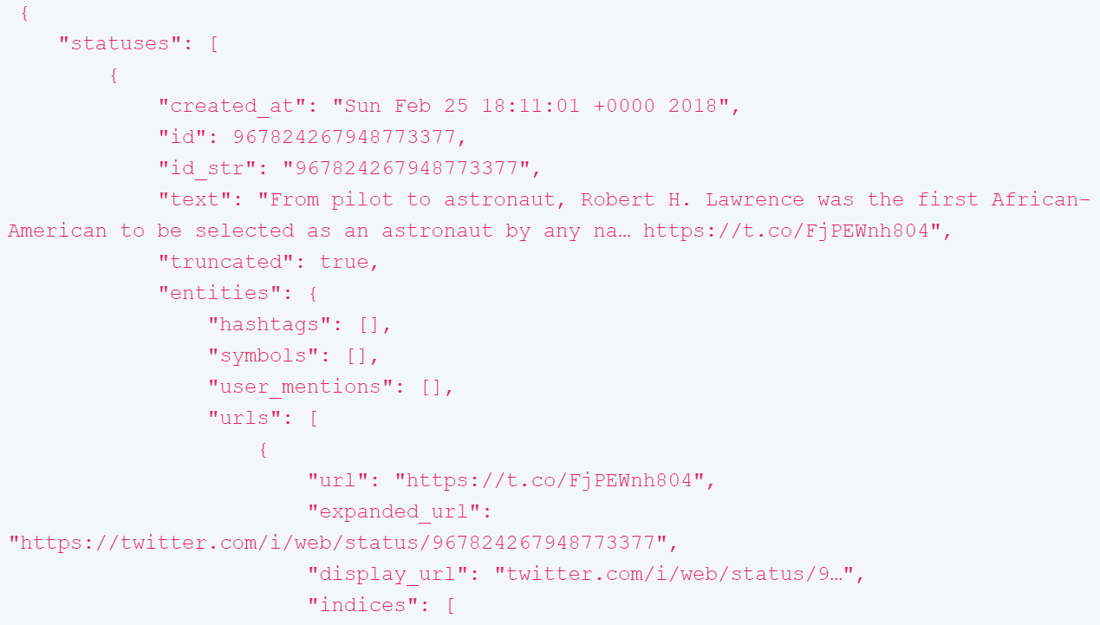
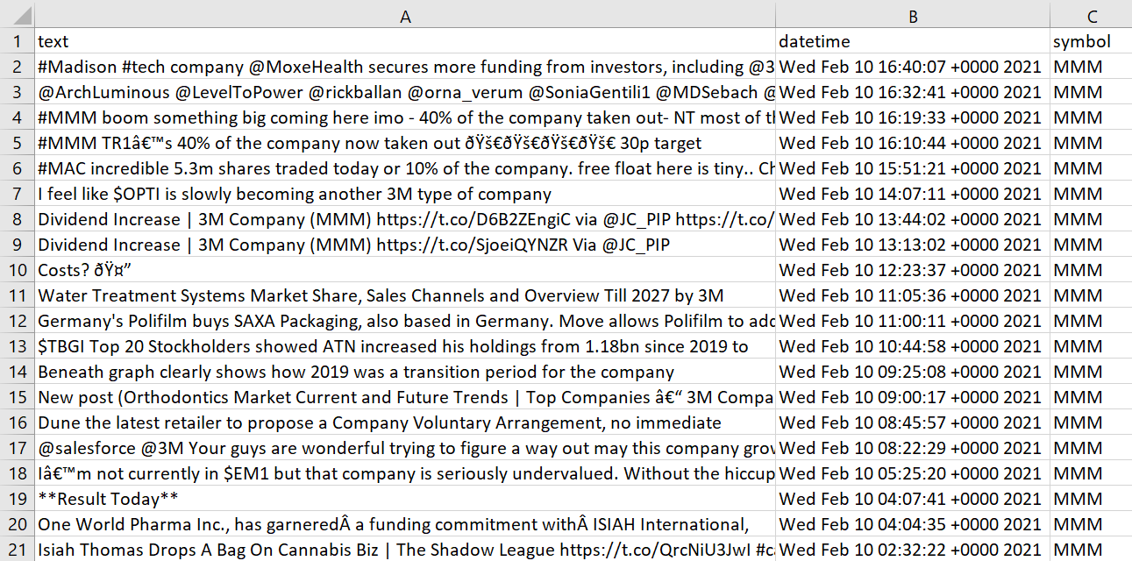
JSON to CSV
Notes:
Crawled twitter for people’s opinion about stocks. Used its API to do the crawling.
Crawled 16595 tweets.
The response in json provided a sizable amount of parameters
Only save the text, datetime, and symbol of the stock in csv

Slide 8
Indexing/ Ranking Optimization

Slide 9
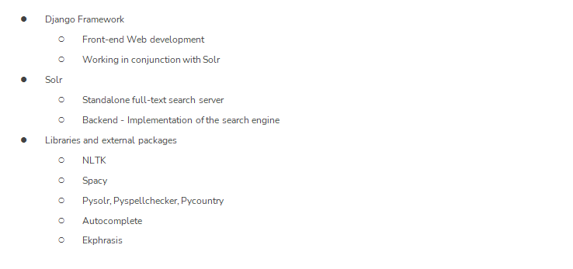
Overview of Framework & Libraries Used

Slide 10
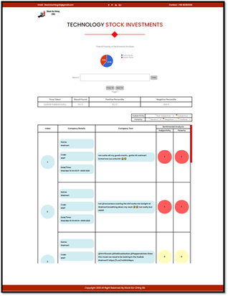
Overview of User Interface
Notes:
Crawled 300 tweets per second

Slide 11
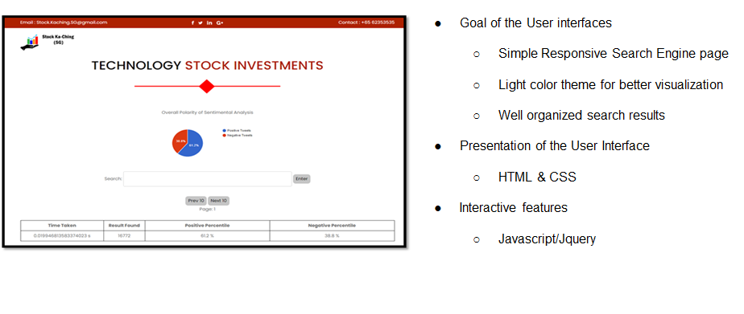
User Interface
Notes:
Crawled 300 tweets per second

Slide 12
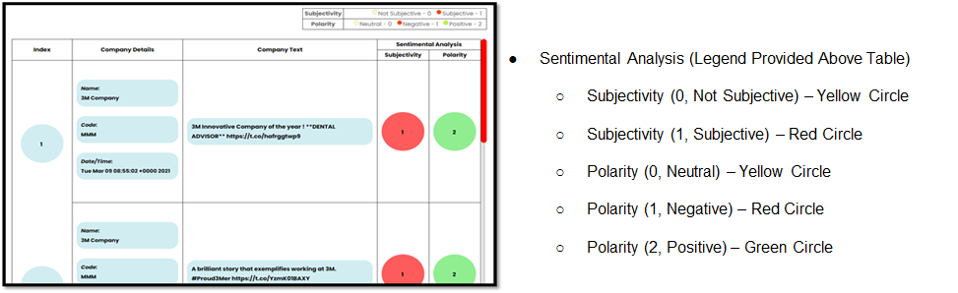
User Interface
Notes:
Crawled 300 tweets per second

Slide 13
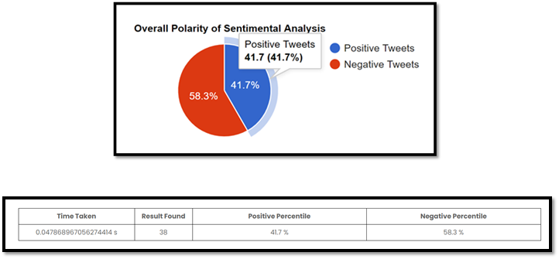
User Interface – Pie Chart
Notes:
Crawled 300 tweets per second

Slide 14
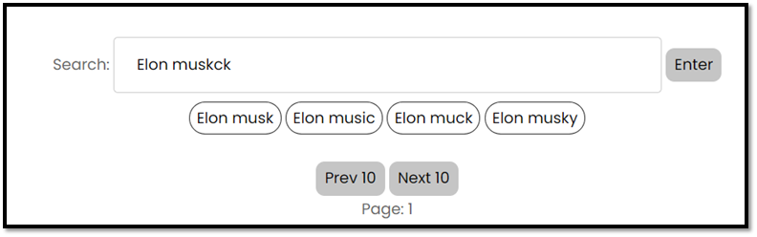
User Interface – Search Suggestions
Notes:
Crawled 300 tweets per second

Slide 15
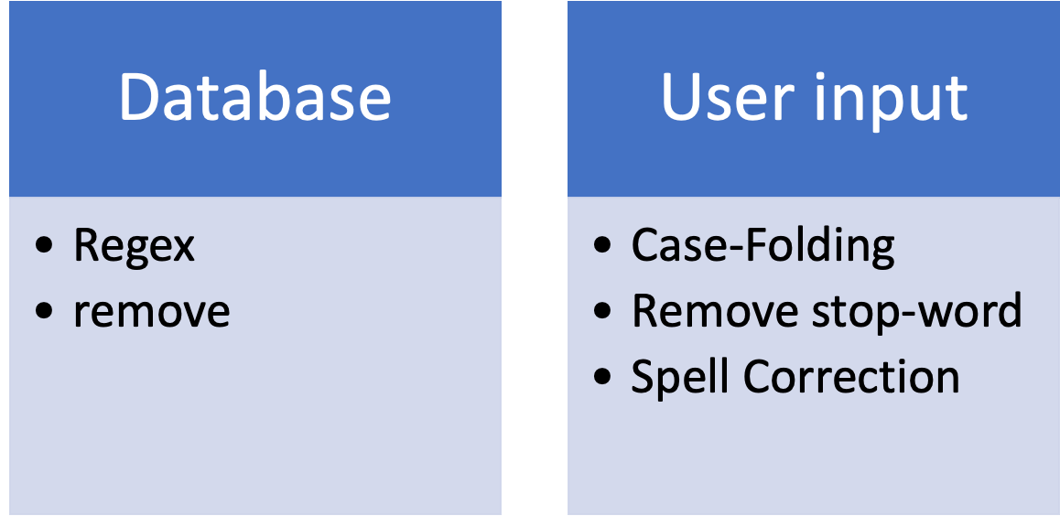
Further Preprocessing

Slide 16
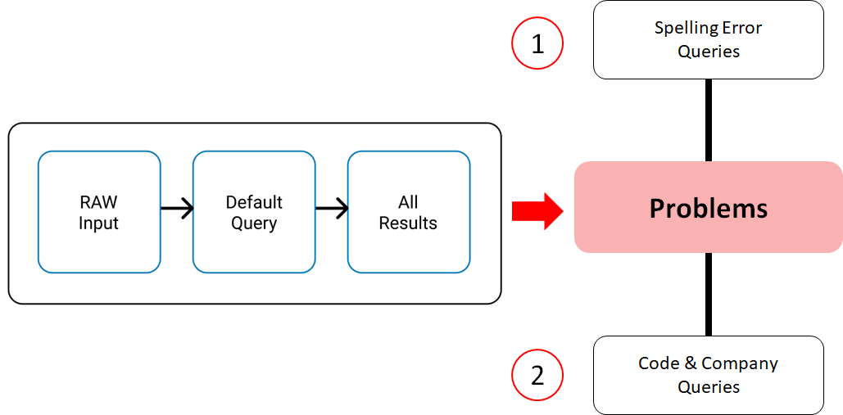
Default Query

Slide 17
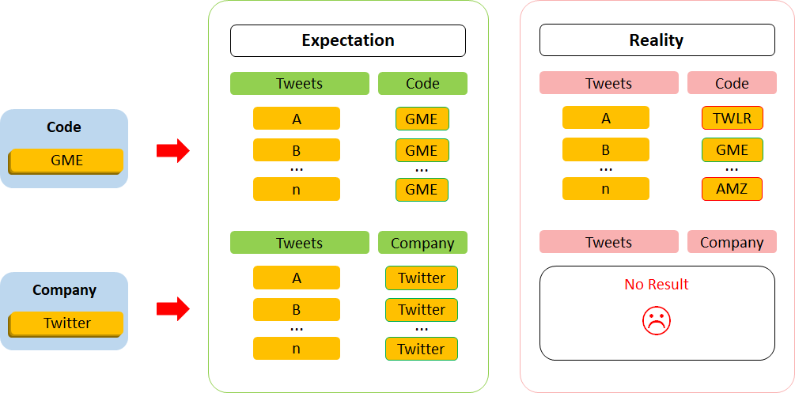
Problem : Handle Code/Company Query

Slide 18
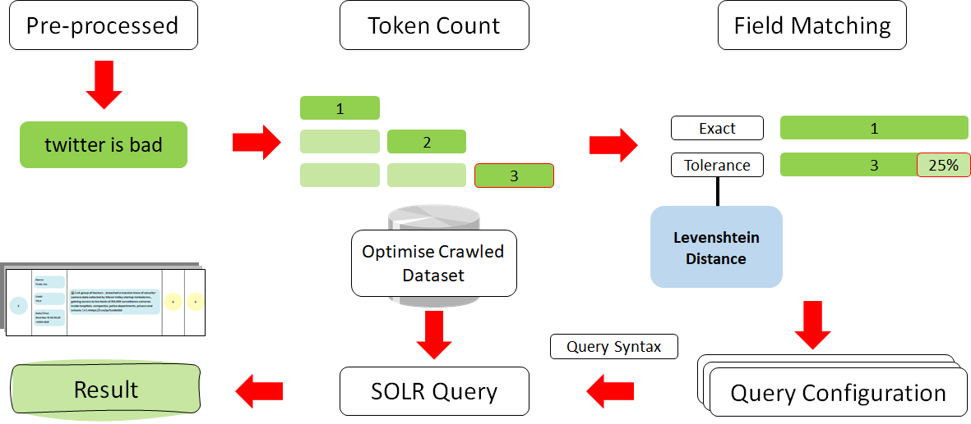
Solution

Slide 19
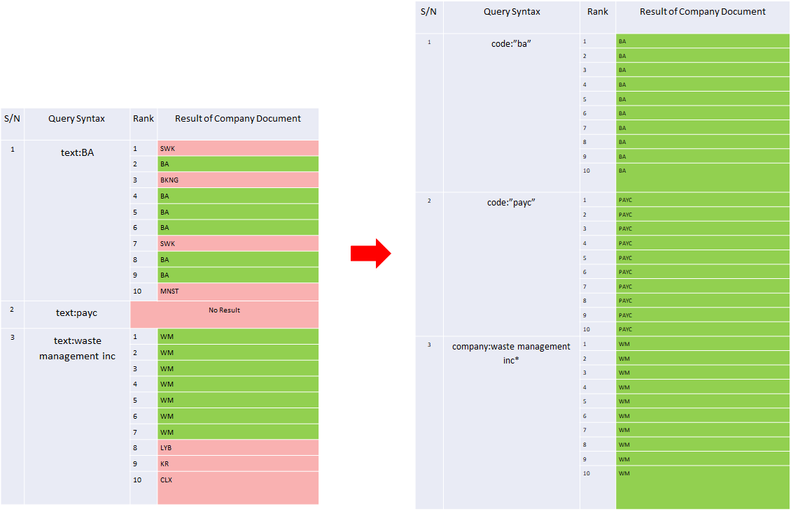
Result

Slide 20
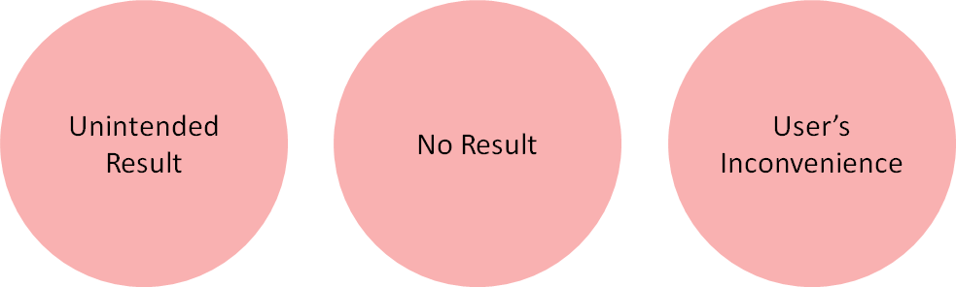
Problem: Handle Spelling Error Query

Slide 21
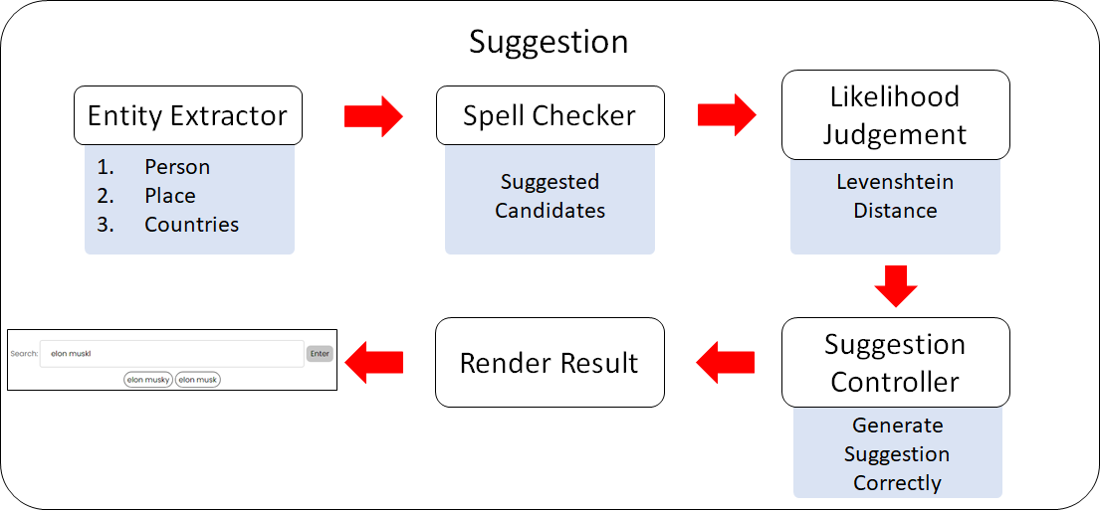
Solution

Slide 22
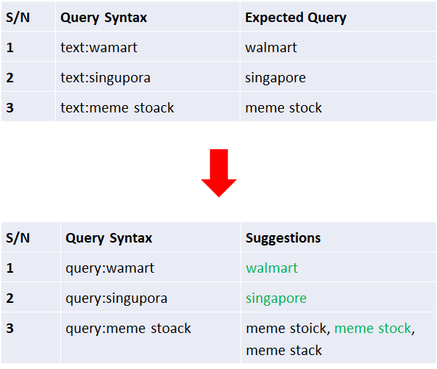
Result

Slide 23
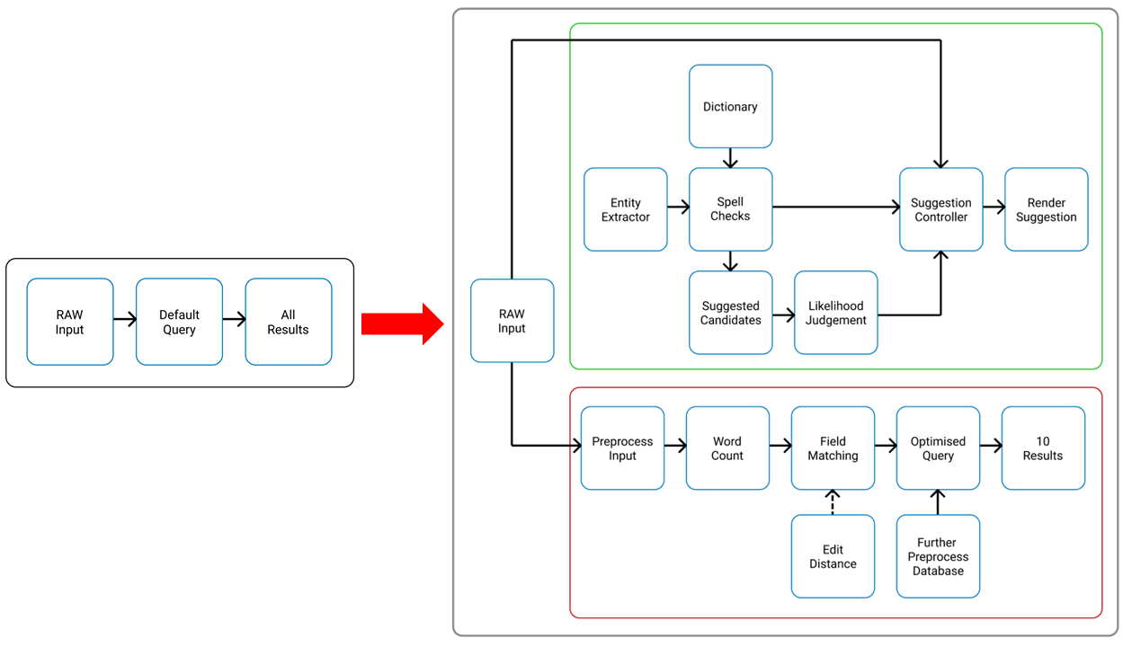
Enhanced
Query

Slide 24
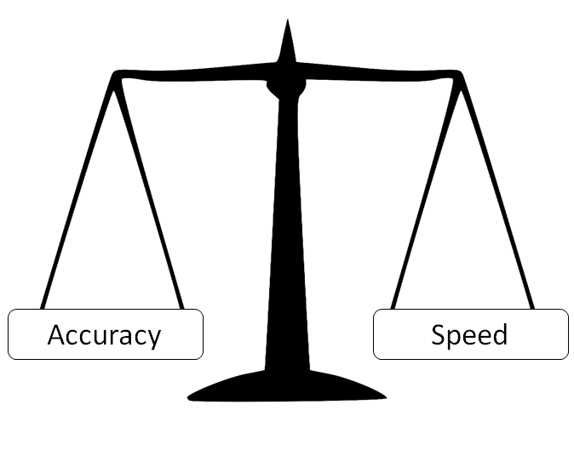
Trade Off

Slide 25
Classification

Slide 26
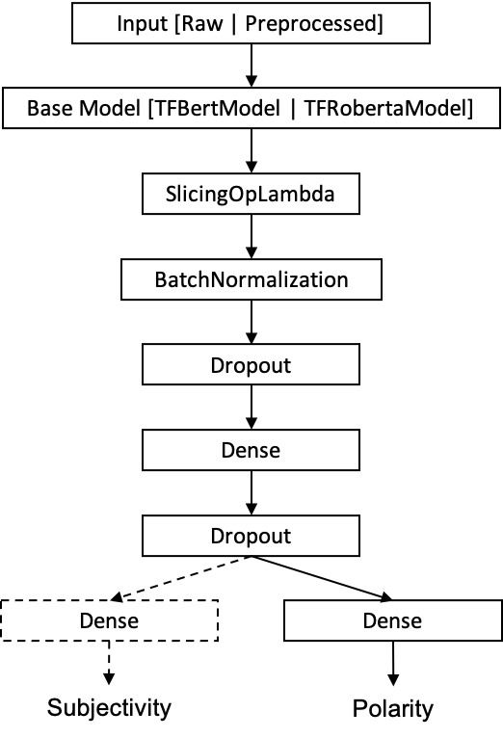
Key Approaches
Text Preprocessing using ekphrasis
Experimented with 2 models, BERT and Twitter-RoBERTa, with 4 variants each
Base
Multitask Classification
Preprocessed Text Input
Multitask Classification with Preprocessed Text Input
Max Voting Ensemble Model
Notes:
Ekphrasis -> a library that uses English Wikipedia and English tweets to perform tasks such as tokenization, word normalisation, word segmentation and spell correction.
BERT can perform extensive data cleaning and preprocessing before tokenization

Slide 27
Comparison of All Models/Approaches
Comparison of Metrics
 | Subjectivity |  |  |  | Polarity
 | Prec. | Rec. | F1. | Acc. | Prec. | Rec. | F1. | Acc.
BERT | NA |  |  |  | 0.707 | 0.697 | 0.662 | 0.697
BERT (Multitask) | 0.744 | 0.748 | 0.744 | 0.748 | 0.715 | 0.721 | 0.713 | 0.721
BERT (Preprocessed) | NA |  |  |  | 0.711 | 0.710 | 0.710 | 0.710
BERT (Multitask, Preprocessed) | 0.727 | 0.728 | 0.715 | 0.728 | 0.702 | 0.689 | 0.647 | 0.689
Tweet-RoBERTa | NA |  |  |  | 0.718 | 0.723 | 0.720 | 0.723
Tweet-RoBERTa (Multitask) | 0.738 | 0.740 | 0.738 | 0.740 | 0.721 | 0.725 | 0.721 | 0.725
Tweet-RoBERTa (Preprocessed) | NA |  |  |  | 0.656 | 0.656 | 0.656 | 0.656
Tweet-RoBERTa (Multitask, Preprocessed) | 0.701 | 0.695 | 0.664 | 0.695 | 0.680 | 0.684 | 0.649 | 0.684
Max Voting Ensemble | 0.748 | 0.751 | 0.748 | 0.751 | 0.730 | 0.734 | 0.729 | 0.734

Slide 28
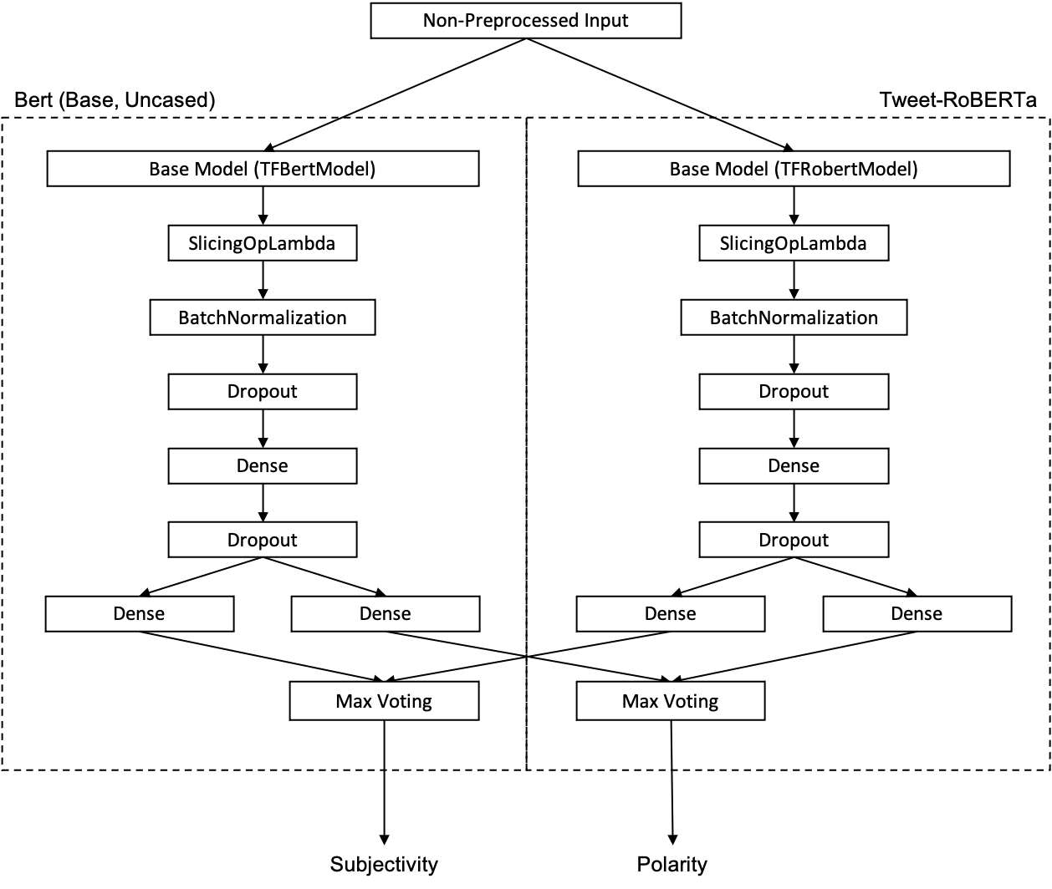
Best Model

Slide 29
Best Model
Ensemble Model Twitter-RoBERTa (Multitask) & BERT (Multitask)
 | Subjectivity |  | Polarity
 | Objective | Subjective | Neutral | Negative | Positive
Precision | 0.778 | 0.699 | 0.782 | 0.591 | 0.675
Recall | 0.831 | 0.624 | 0.835 | 0.644 | 0.538
F1-Score | 0.804 | 0.660 | 0.808 | 0.616 | 0.599
Accuracy | 0.751 |  | 0.734

Slide 30
Classification Metrics
Description | Value
Crawl Time per Tweet | 149.73ms
Tweets Crawled per Second | ~300
Classification Time per Tweet | 9.53ms
Tweets Classified per Second | ~105
Model Training Time per Epoch | 43.80s
Overall Model Training Time | 438s

Slide 31
Conclusion
Crawling
Indexing and Querying
Classification

